Slide 1


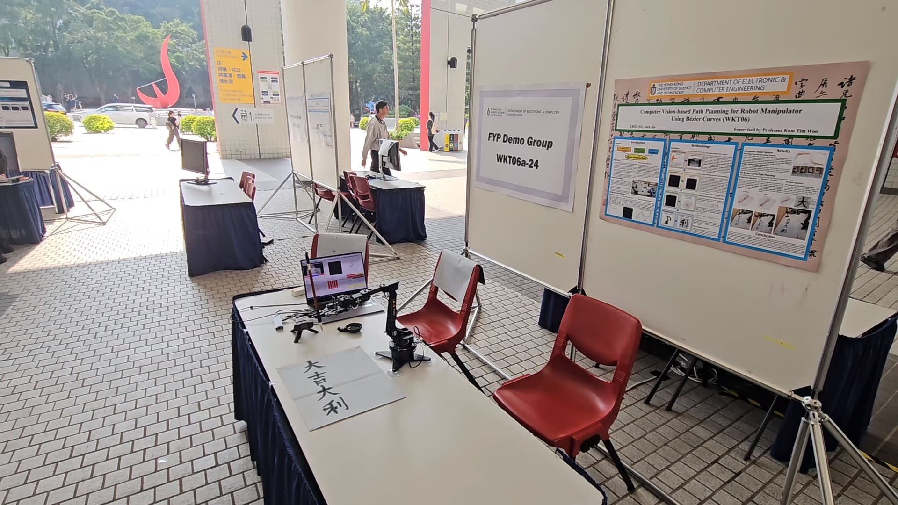
Advanced 3D Path Planning for Robotic Calligraphy Based on LLM-Driven Text Prompts
Track A1F2 CSR 1:
Control Systems & Robotics (CSR) 1
28 Oct 2025 8:45am
Presenter 1: Cheuk Tung Shadow Yiu,
Presenter 2: Dick Ho Cheung (Dicaprio),
Co-Author: Haolun Huang,
Supervisor: Professor Kam Tim Woo
Notes:
Good morning everyone,
I am YIU Cheuk Tung, and you can call me Shadow.
Beside me is my lab mate, Dicaprio.
We are from The Hong Kong University of Science and Technology.
Today, We will present our paper on
“Advanced 3D Path Planning for Robotic Calligraphy Based on LLM-Driven Text Prompts”

Slide 2
TABLE OF CONTENTS
01
02
03
04
Introduction
Methodology
Result and Analysis
Video Demo
Notes:
Here’s the outline of today’s presentation.​

Slide 3
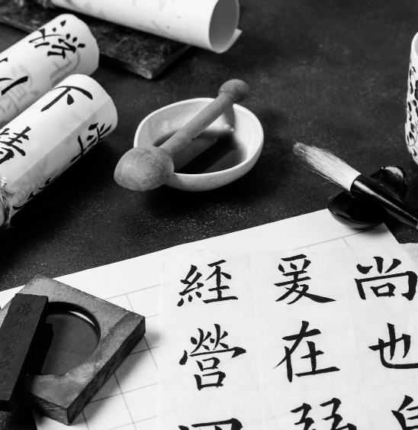
01
INTRODUCTION
Background of this project

Slide 4
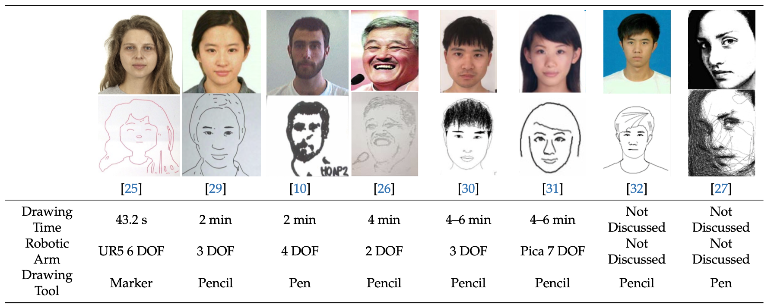
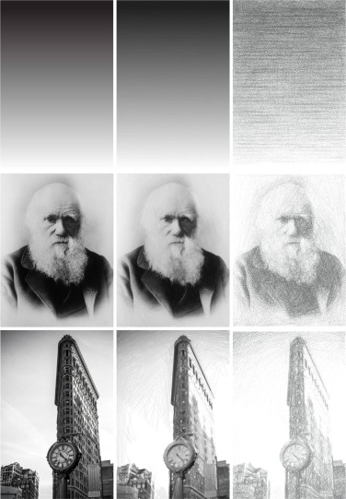
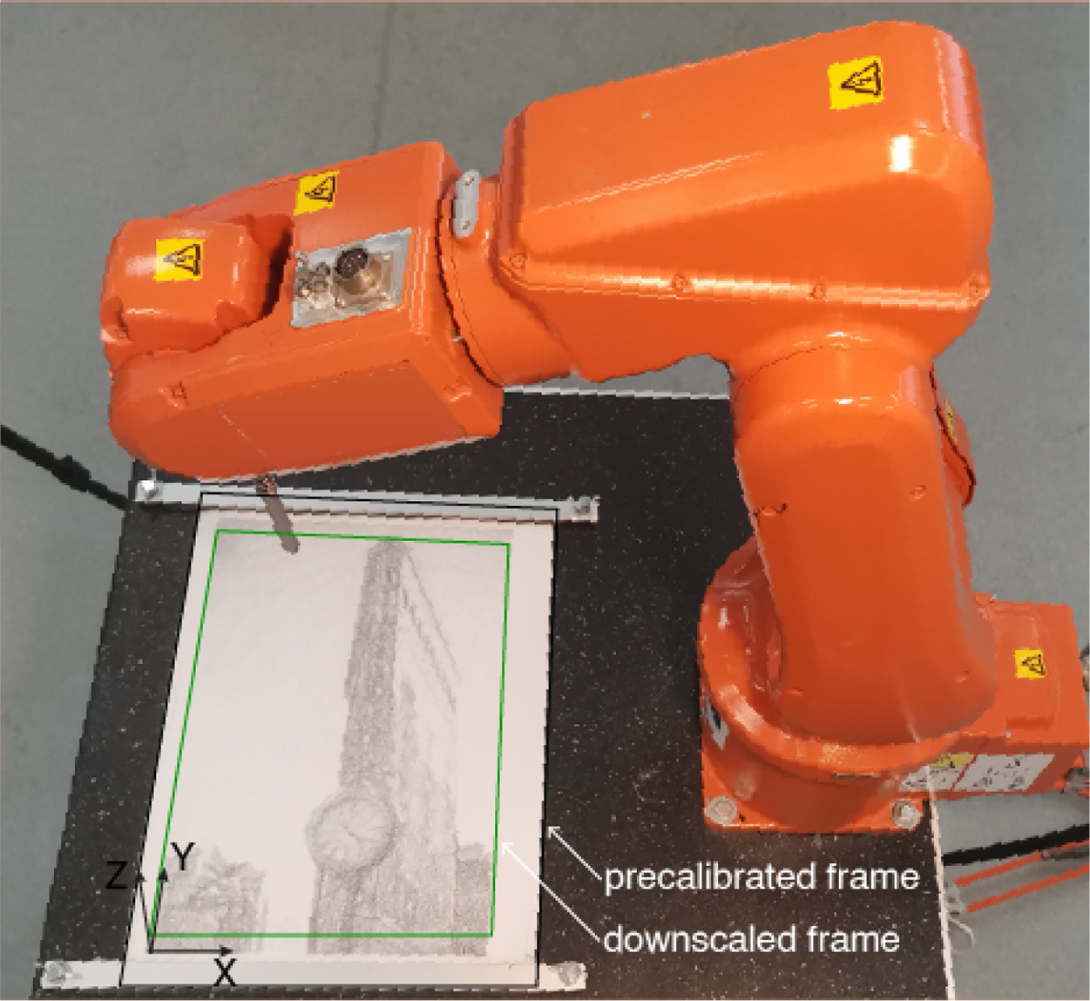
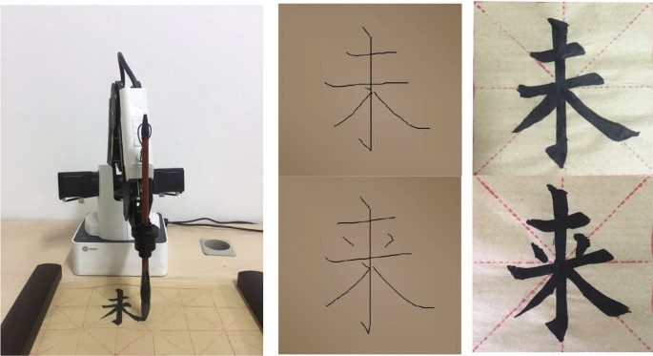
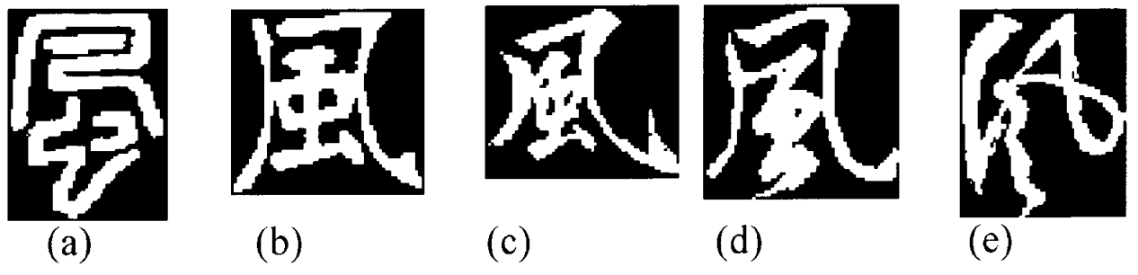
Introduction
Artistic Robot Drawing and Writing
Notes:
Artistic robotics refers to the use of multi-axis robotic manipulators to produce visually expressive work under software control.
Robot drawing, writing and calligraphy have attracted immense interest.

Slide 5
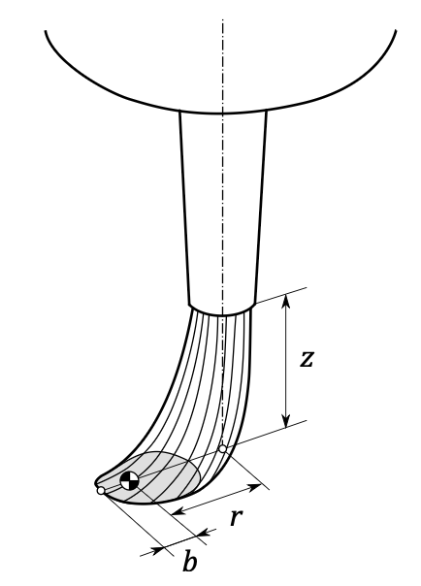
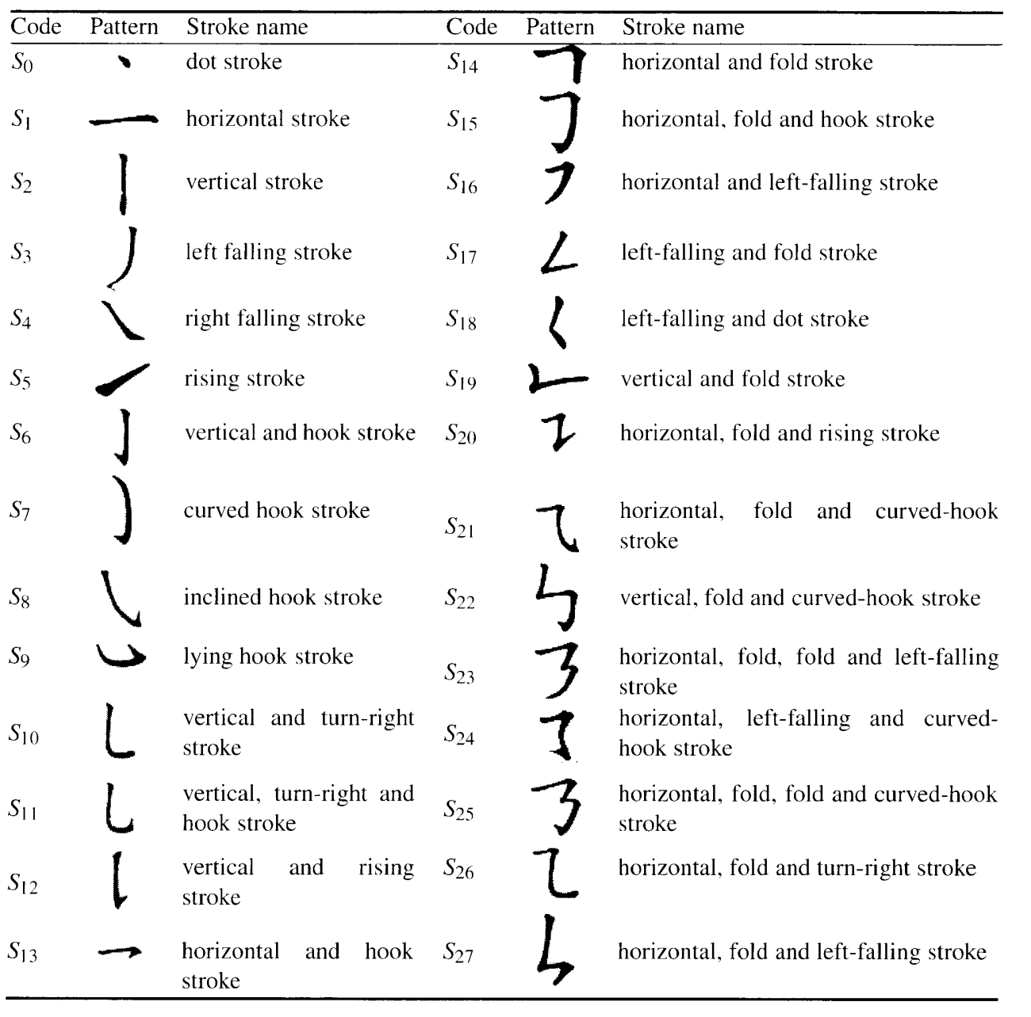
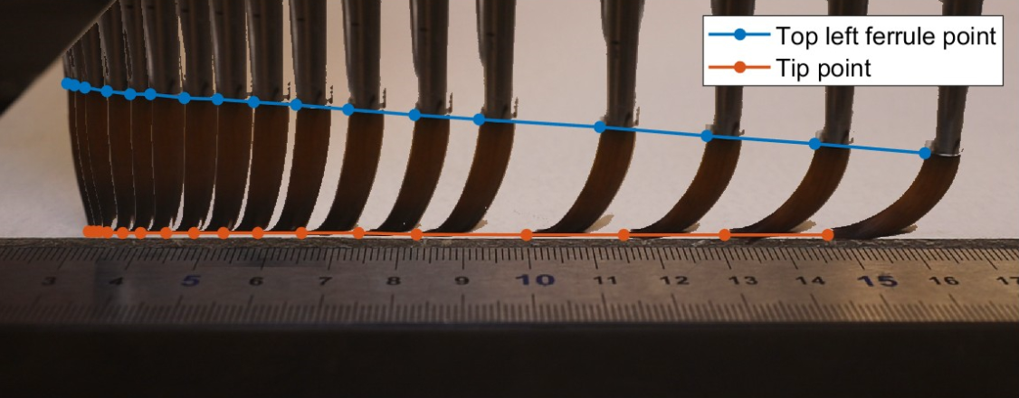
Review
Improving 3D Trajectories for Robotic Calligraphy
Notes:
Accurate 3D paths are crucial for robot calligraphy.
They let the robot change brush angle, pressure, and curve to create expressive, flowing lines.
Without precise 3D planning, the writing looks flat and mechanical instead of lively and artistic.

Slide 6
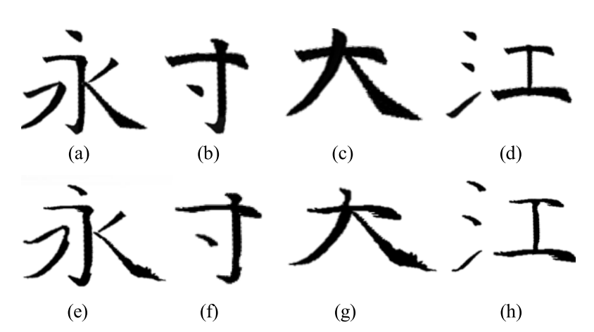
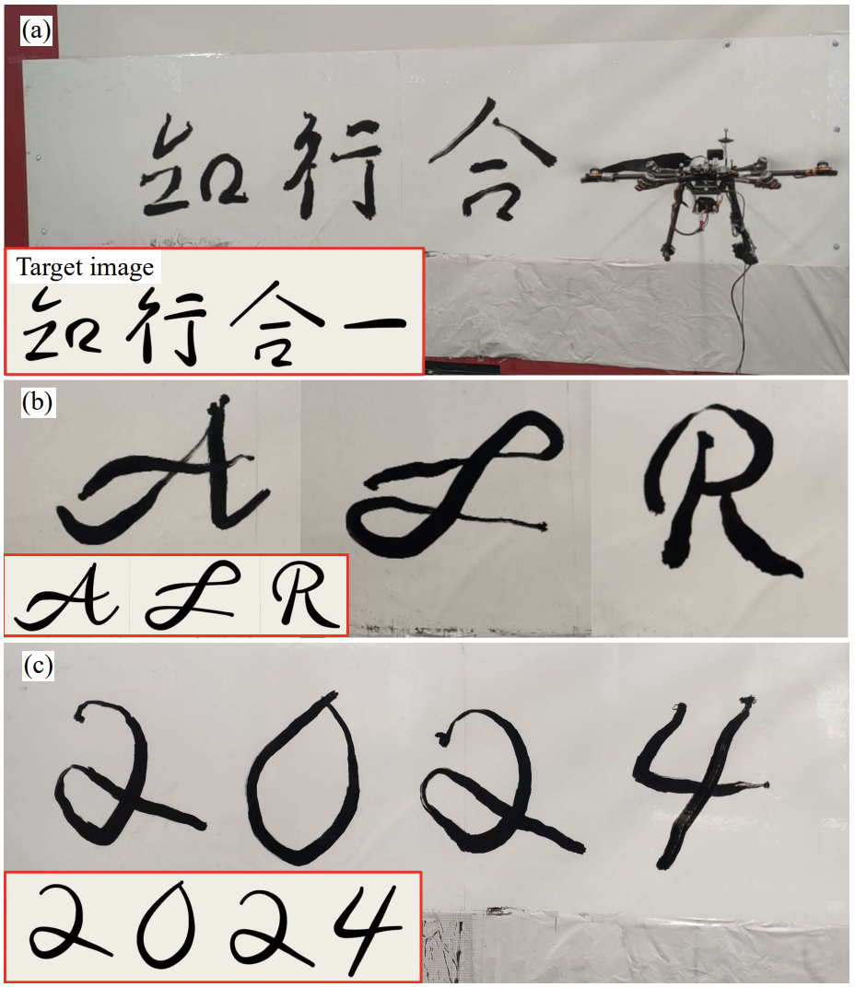
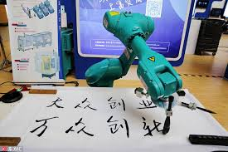
Review
We need to Enable Dynamic 3D Brush Trajectories for Any Text Prompt
Notes:
Many existing calligraphy robots are limited to writing only a small set of predefined characters or phrases.
They perform well on those limited words but can’t handle new text or arbitrary input.
To bring true flexibility and expressiveness to robotic calligraphy,
we need a dynamic system that generates 3D brush trajectories for any text prompt.

Slide 7
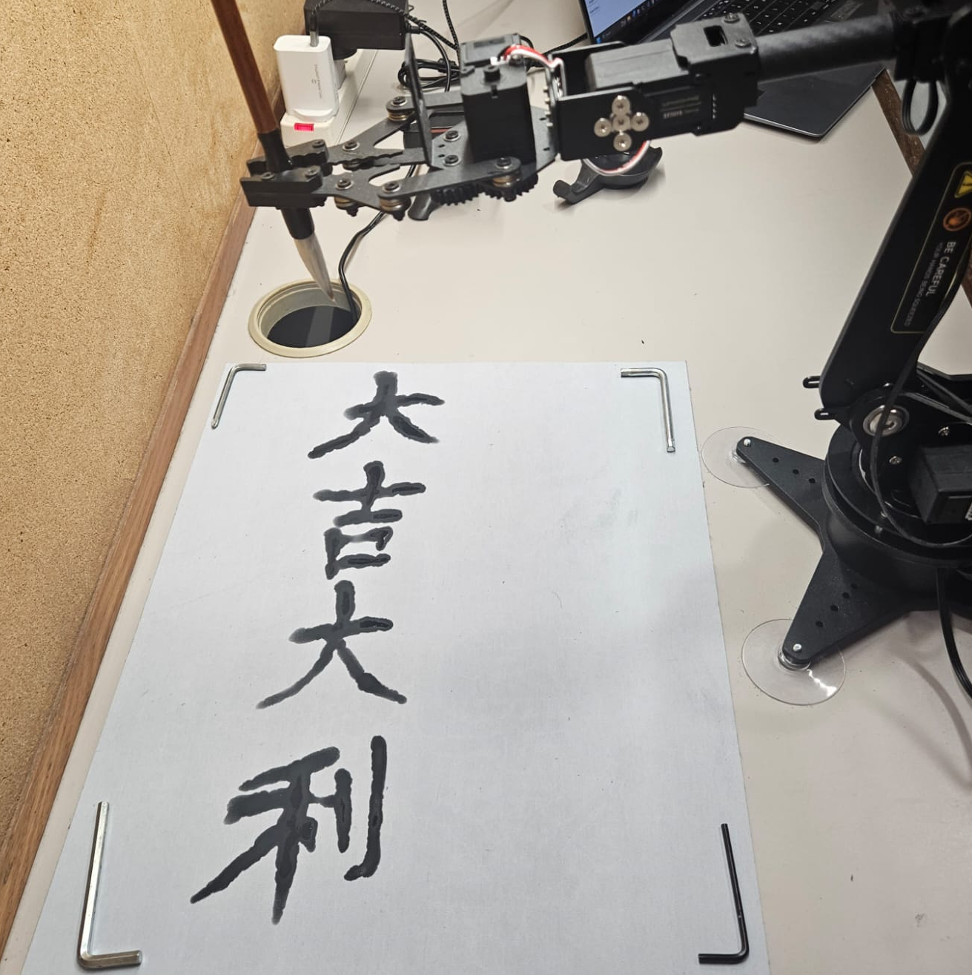

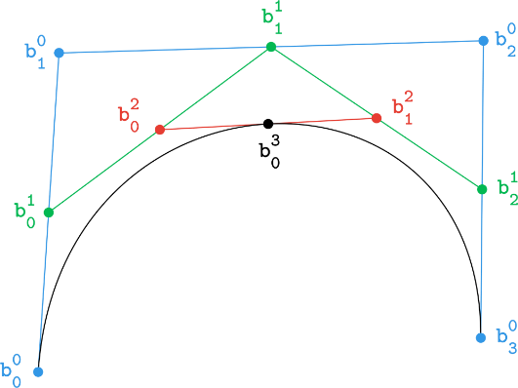
Overview
LLM-Driven
Text Prompt
3D Path Planning
Robot Calligraphy
Q: 幫我寫…
(Help me write …)
LLM Generate
4 Chinese Characters Idioms
(四字揮春)
Smooth 3D Hermite Spline Trajectory
Write Chinese Calligraphy with Robotic Arm
Notes:
So, there is the overview of our project.
[press] In our system, we can use ChatGPT to generate text prompts,
[press] use Smooth 3D Hermite Splines to convert the Chinese characters into robot trajectories,
[press] and use Robotic Arm to turn the simulated paths into reality.

Slide 8
02
METHODOLOGY
Key concepts of this project
Notes:
Now I’ll pass my time to Dicaprio to talk about our methodology.

Slide 9
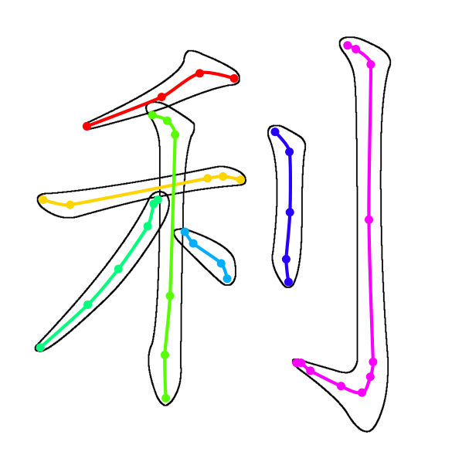
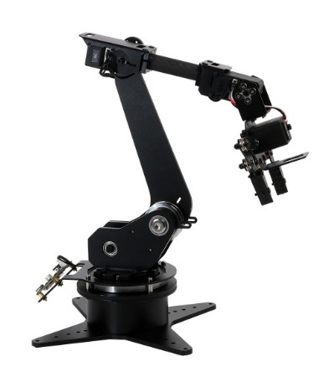
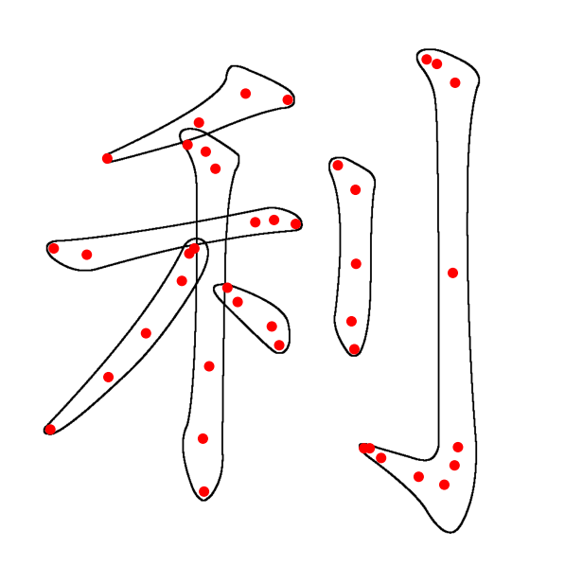


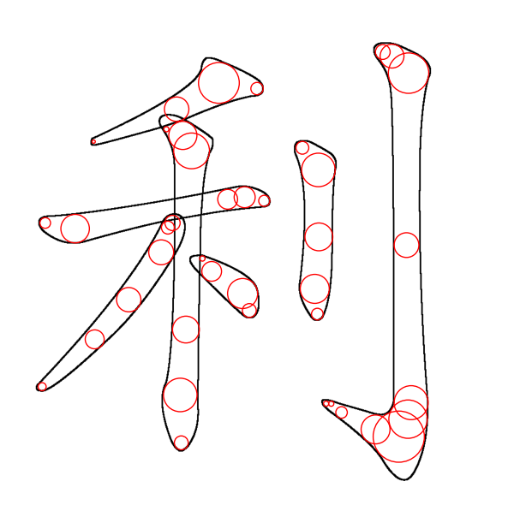
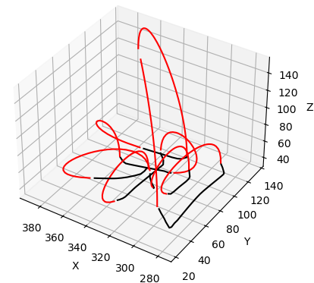
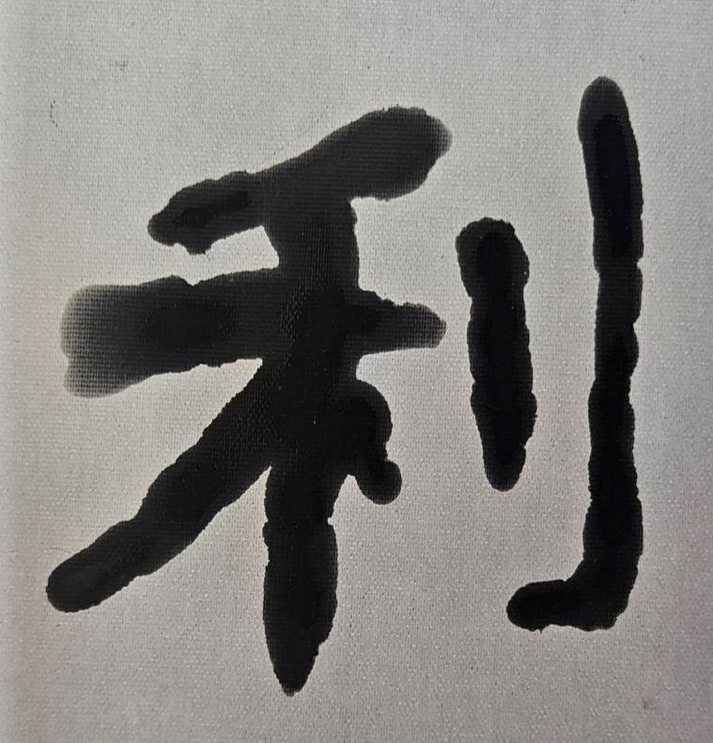
Workflow
Control Point Generation
Trajectory Generation
Robot Manipulation
Fetch 2D
Control Points
3D Hermite Splines
Control Robotic Arm
ChatGPT - 4o
Q: 幫我寫一個關於春節
的四字詞語。
(Help me write a four-
character idiom related
to Spring Festival.)
Generate 3D
Control Points
Add Connecting
Hermite Curves
Chinese Calligraphy
A: 大吉大利
(Great luck
and great profit)
Notes:
This is the workflow of our Chinese calligraphy robotic arm system.

Slide 10
Generate Text Prompts with LLM
Control Point Generation
Trajectory Generation
Robot Manipulation
Fetch 2D
Control Points
3D Hermite Splines
Control Robotic Arm
ChatGPT - 4o
Q: 幫我寫一個關於春節
的四字詞語。
(Help me write a four-
character idiom related
to Spring Festival.)
Generate 3D
Control Points
Add Connecting
Hermite Curves
Chinese Calligraphy
A: 大吉大利
(Great luck
and great profit)
Notes:
And I will talk about the LLM part in detail first.

Slide 11
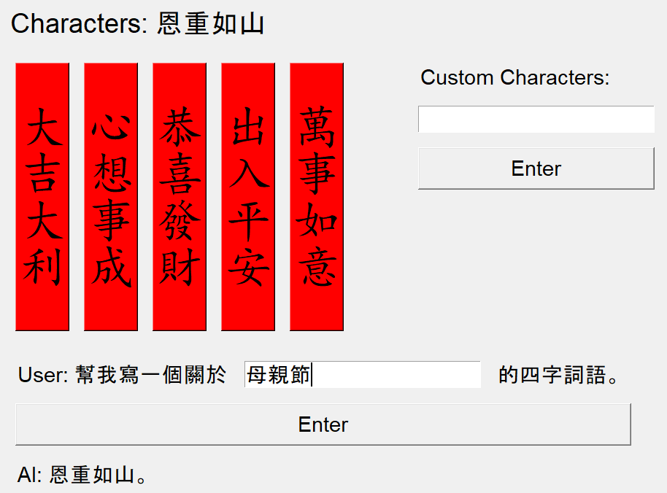
ChatGPT Suggest Idioms
ChatGPT - 4o
Q: 幫我寫一個關於母親節
的四字詞語。
(Help me write a four-
character idiom related
to Mother’s Day.)
A: 恩重如山
(Gratitude as heavy
as a mountain)
Notes:
This is a part of the UI that controls the robotic arm. We asks the users to input a specific topic or a festival. Then, the ChatGPT API would help us think of some relevant Fai Chu, or we can call it Chinese idioms. As ChatGPT’s output is non-deterministic, the Chinese characters it outputs are relatively random each time. So, our robotic arm needs to handle all possible Chinese characters.

Slide 12

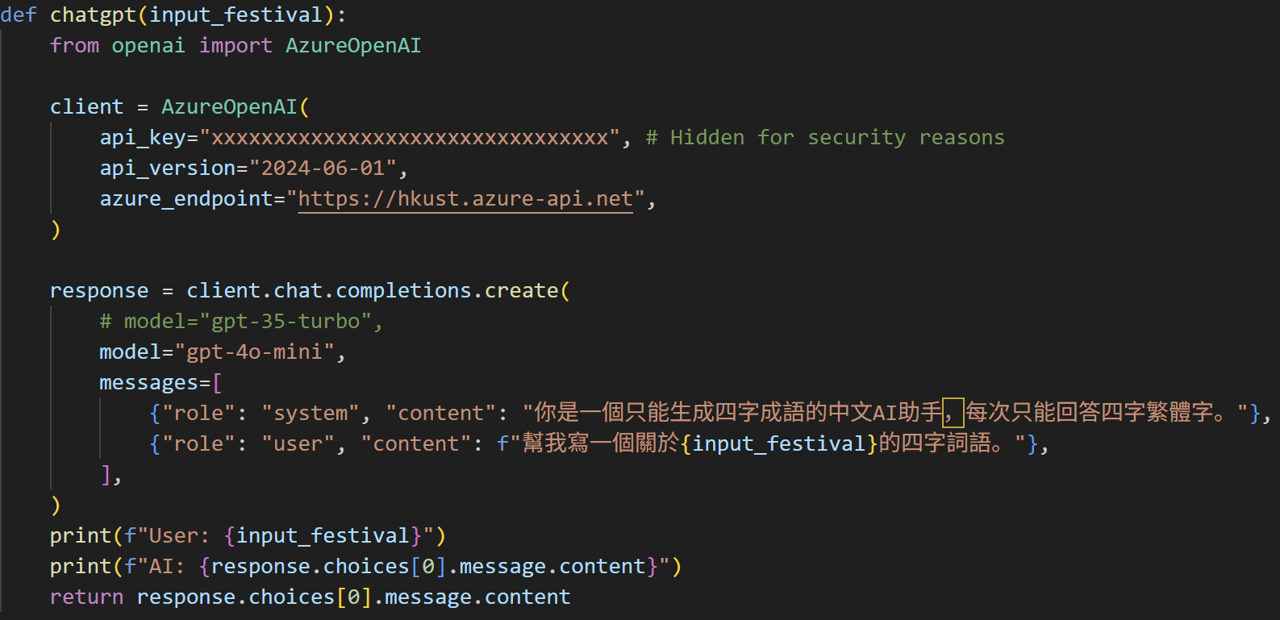
Powered by HKUST Azure OpenAI API
Easy & Free Access of ChatGPT
Empowers
Innovative Student Projects
Notes:
This ChatGPT feature is supported by HKUST OpenAI API services that is available to all HKUST students. The easy and free access of ChatGPT and other genAI empowers students like me to build innovative solutions with AI and to gain valuable experience.

Slide 13
Control Point Generation
Control Point Generation
Trajectory Generation
Robot Manipulation
Fetch 2D Control Points
3D Hermite Splines
Control Robotic Arm
ChatGPT - 4o
Q: 幫我寫一個關於春節
的四字詞語。
(Help me write a four-
character idiom related
to Spring Festival.)
Generate 3D
Control Points
Add Connecting
Hermite Curves
Chinese Calligraphy
A: 大吉大利
(Great luck
and great profit)
Notes:
So, the next part is to convert the Chinese characters into control points

Slide 14
Fetch 2D Control Points
From Make Me a Hanzi Dataset
Has 9574 most common Chinese characters
Includes both simplified and traditional Chinese
Contains stroke-ordered control points
Contains vector graphics of the shape of each Chinese character
Make Me a Hanzi dataset: https://github.com/skishore/makemeahanzi
Notes:
I fetch the 2D control points of the chosen Chinese characters from an open-source dataset called Make Me a Hanzi. This dataset contains more than 9000 most common simplified and traditional Chinese characters so it can handle all different characters generated by ChatGPT. T

Slide 15
Fetch 2D Control Points
From Make Me a Hanzi Dataset
Red, stroke-ordered,
2D control points
Stroke-ordered SVG path for the Black boundary of the Chinese character
Notes:
This dataset contains the red control points that are listed in stroke order. So, we can follow the order of different red control points to write the Chinese characters. It also has the svg paths of the black boundary of the characters so we know what our character should looks like after we write it using the calligraphy brush.

Slide 16
Why 3D Path Planning?
Because Height of Brush affects Stroke Thickness
Brush Lift Up = Thin strokes
Brush Press Down = Thick strokes
Notes:
You might ask, Why is it 3D Path Planning when we are writing on a 2D paper using 2D control points? It is because if we draw a line with the Chinese Calligraphy brush lifted high in the air barely touching the paper, the line it draws would be thin. But If we press the brush onto the paper, the stroke would be thick. So, the height of the brush (which is the z-axis of the 3D plane) affects the thickness of the brush strokes it writes. So, we propose the following method to control the thickness of the strokes to make robot calligraphy a much simpler task.

Slide 17
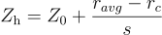

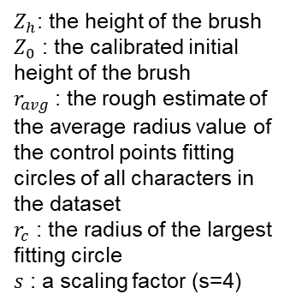
Calculate 3D control points
using Largest Fitting Circles
$Z_{h}$: the height of the brush
$Z_{0}$ : the calibrated initial height of the brush
$r_{avg}$ : the rough estimate of the average radius value of the control points fitting circles of all characters in the dataset
$r_{c}$ : the radius of the largest fitting circle
$s$ : a scaling factor (s=4)
Notes:
So, for each red 2D control points we fetched from the dataset, we run a largest fitting circle algorithm until it touches the black boundary. The size of these circles represent the stroke thickness at that specific control point. As stroke thickness correlates to the height of the brush. So, we can calculate the z-axis of the control points using the radius of the largest fitting circles. We calculates the Z coordinates using this simple linear equation.

Slide 18
Trajectory Generation
Control Point Generation
Trajectory Generation
Robot Manipulation
Fetch 2D
Control Points
3D Hermite Splines
Control Robotic Arm
ChatGPT - 4o
Q: 幫我寫一個關於新年
的四字詞語。
(Help me write a four-
character idiom related
to Chinese New Year.)
Generate 3D
Control Points
Add Connecting
Hermite Curves
Chinese Calligraphy
A: 大吉大利
(Great luck
and great profit)
Notes:
With the Z-coordinates added to each 2D control points, we can connect these 3D control points together into a smooth trajectory for the robotic arm to run.

Slide 19
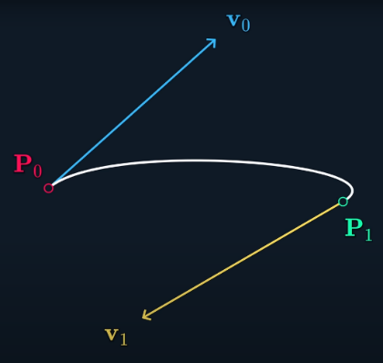
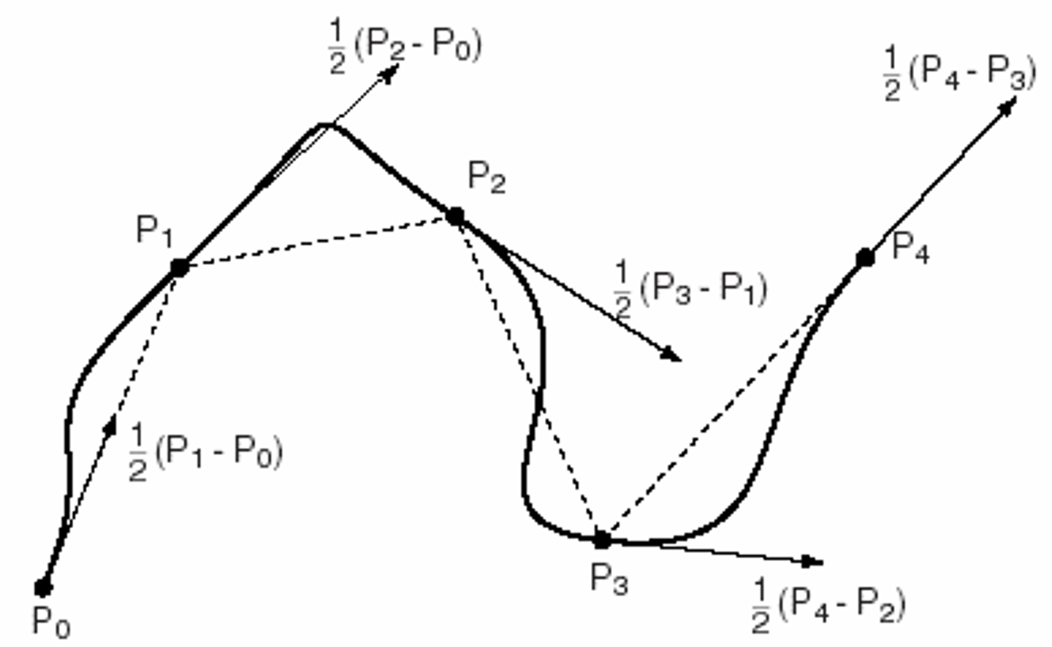
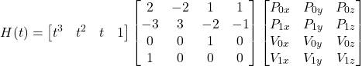

CONCEPTS
Hermite Curve
Catmull-Rom Spline
I connect 2 control points together with Hermite curve.
But we are missing v0 and v1
So, I uses Catmull-Rom Spline to calculate v0 and v1 to connect multiple Hermite curves
Notes:
I uses Hermite curve, which is a variant of Bezier curve, to connect 2 control points together. As there are more than 2 control points in a stroke, I tried to use Catmull-Rom Spline to calculate the control velocities v0 and v1 of the Hermite curve to connect multiple Hermite curves together.

Slide 20
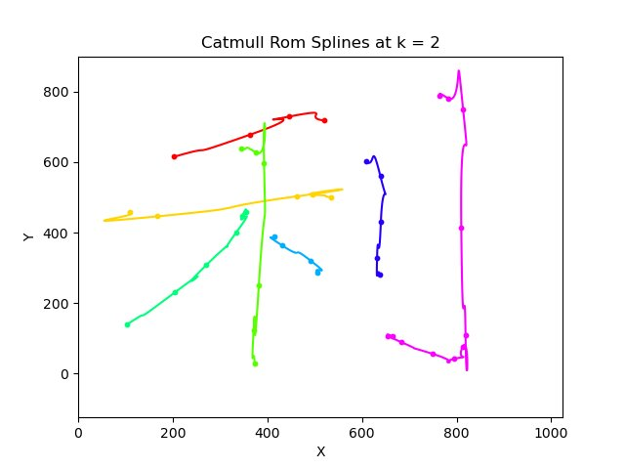
But Catmull-Rom Spline is not good
Notes:
However, Catmull-Rom Spline creates these strange backward movement as the control points are not uniformly spaced.

Slide 21
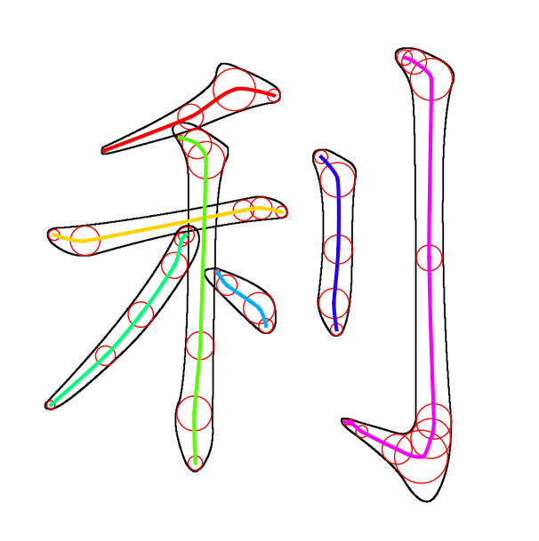
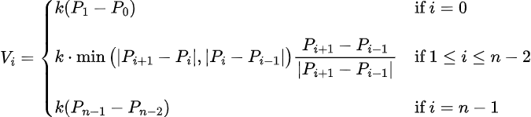
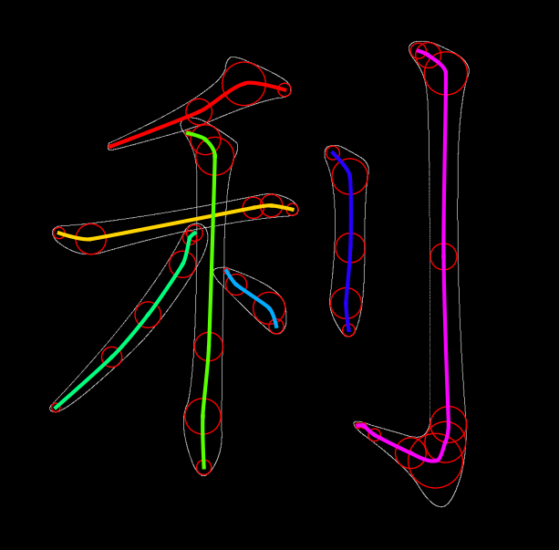
Modified Catmull-Rom Spline
Notes:
So, the 3D control points are connected using a modified catmull-rom spline to ensure that the trajectory passes through each and every control points smoothly without sudden change in velocity. This spline only connects the points within a stroke.

Slide 22
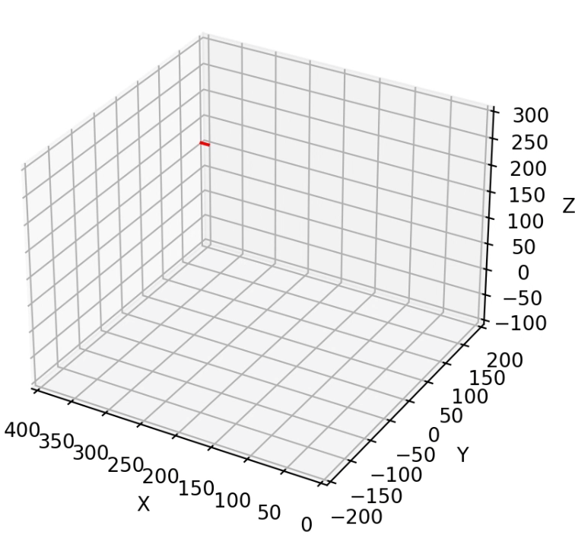
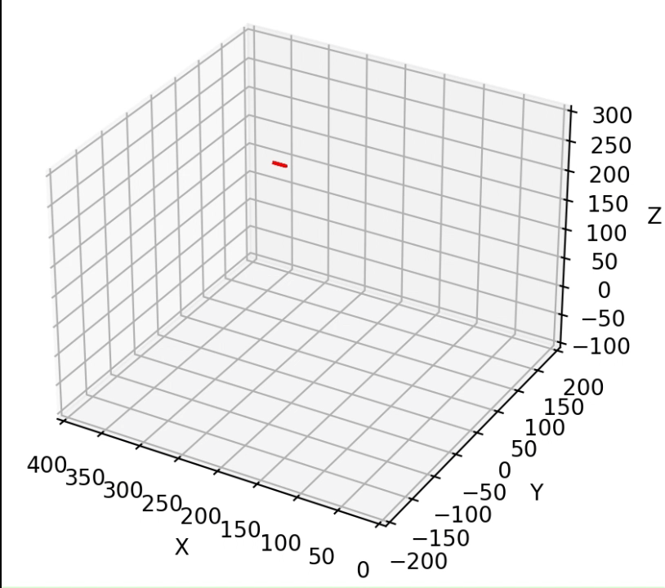
Connecting Hermite Curves
First version for 2D Spline Algorithm
Final version for 3D Spline Algorithm
Notes:
After connecting the control points within a stroke, I added these red connecting Hermite curves to control it to lift up the brush and go to the next stroke. Originally, I uses this Hermite curve that directly goes up and down to connect them. However, the sudden change of direction from going horizontally along the paper to vertically up is not smooth. Therefore, I modified the starting velocity vector into this horizontal along the previous movement direction to make it smoothly lift up the brush with G1 continuity.

Slide 23
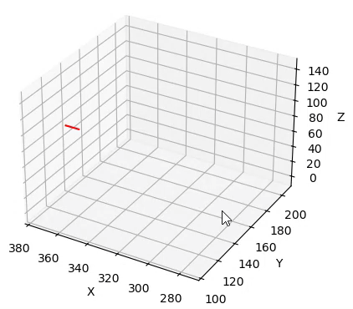
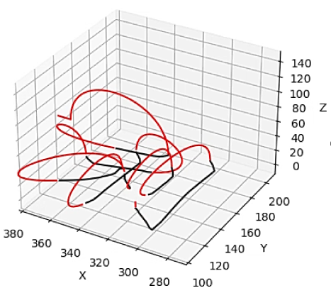
Connecting Hermite Curves
Final version for 3D Spline Algorithm
Notes:
, this is why we need to add these red connecting Hermite Curves to connect multiple strokes together. These red connecting hermite curve not only connects different strokes together, it also handles how we lift the brush up after writing a stroke and how we put the brush down to write the next stroke. This connecting Hermite curve has C1 continuity with the previous catmull-rom spline, ensuring a smooth brush lifting up motion after writing each stroke.

Slide 24
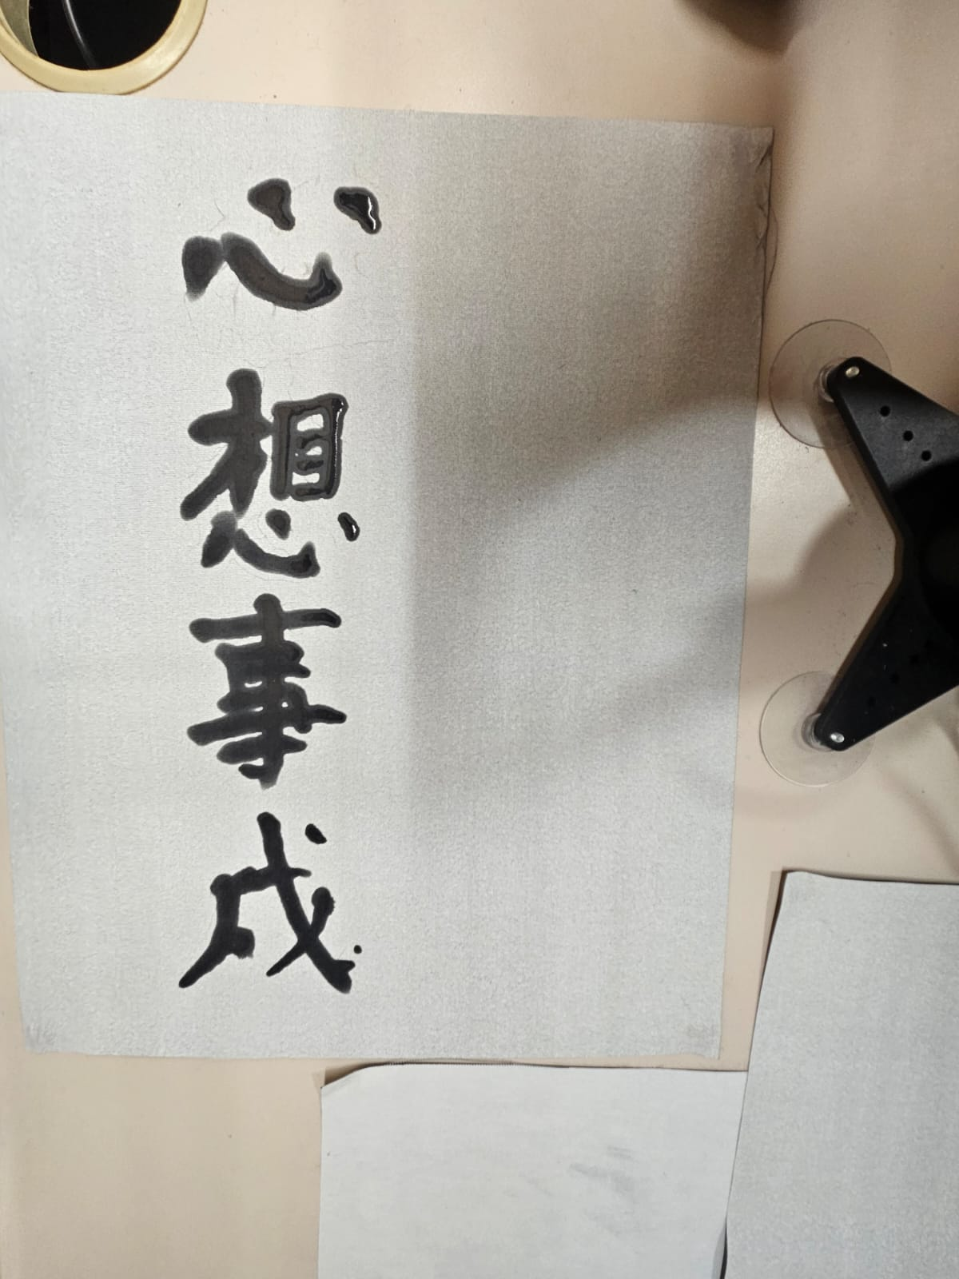
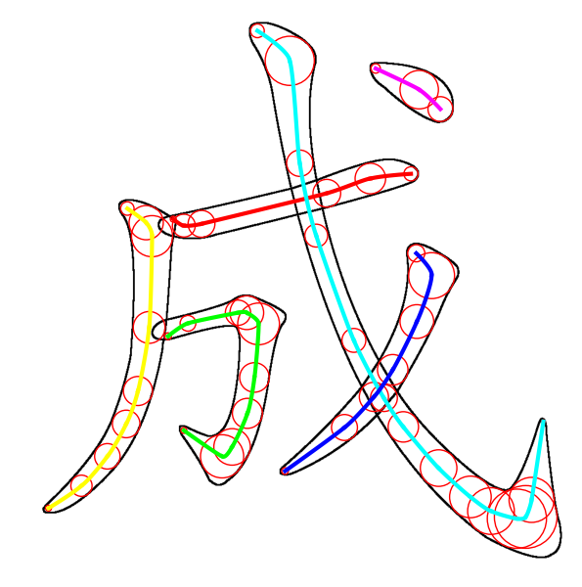
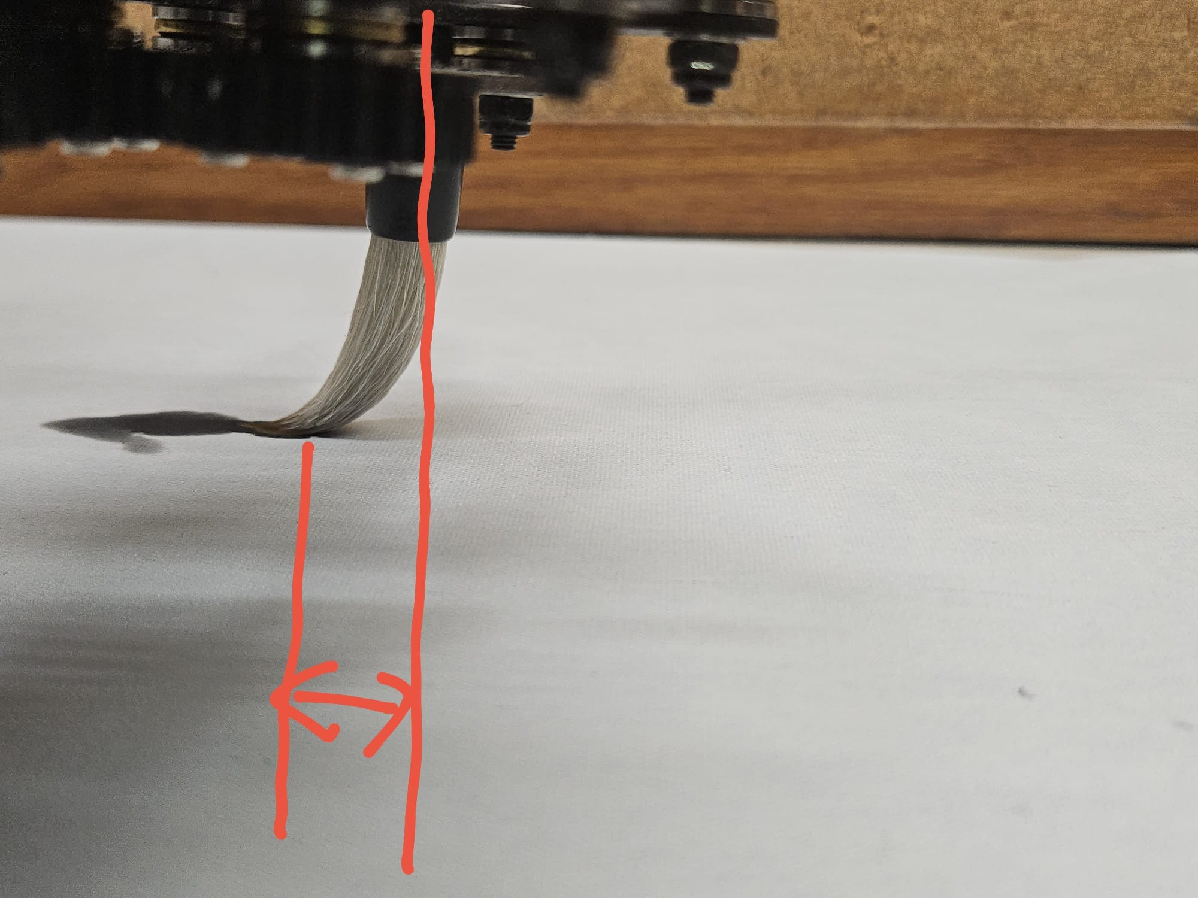
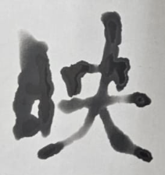
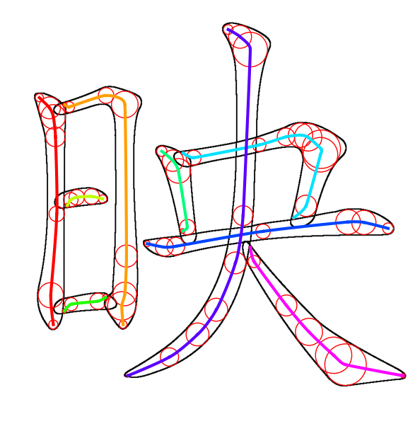
Brush Correction Algorithm
ERROR!
Notes:
After some testing, I found that the reason why it can’t write complex strokes clearly is because there is an error distance between the brush body and the brush tip. This cause it to move diagonally when it needs to move in a L shape. I thought of a way to correct this error AFTER I submitted my final report so this is not included in the report.

Slide 25
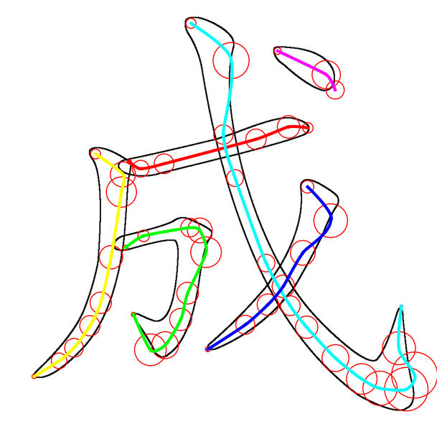
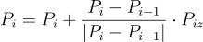
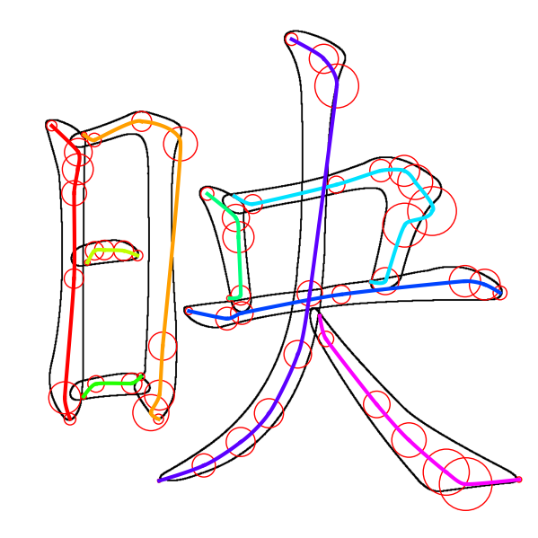
Brush Correction Algorithm
Notes:
So, I shift the original control points in the direction from previous point to current point. So, if it is a straight line, the shifted position is still on the line. But if the line is in L-shaped, it would go a little bit outward to compensate the error.

Slide 26
Robot Manipulation
Control Point Generation
Trajectory Generation
Robot Manipulation
Fetch 2D
Control Points
3D Hermite Splines
Control Robotic Arm
ChatGPT - 4o
Q: 幫我寫一個關於春節
的四字詞語。
(Help me write a four-
character idiom related
to Spring Festival.)
Generate 3D
Control Points
Add Connecting
Hermite Curves
Chinese Calligraphy
A: 大吉大利
(Great luck
and great profit)
Notes:
After we computes the trajectory of the characters, we can control the robotic arm to follow the trajectory to write the Chinese calligraphy.

Slide 27
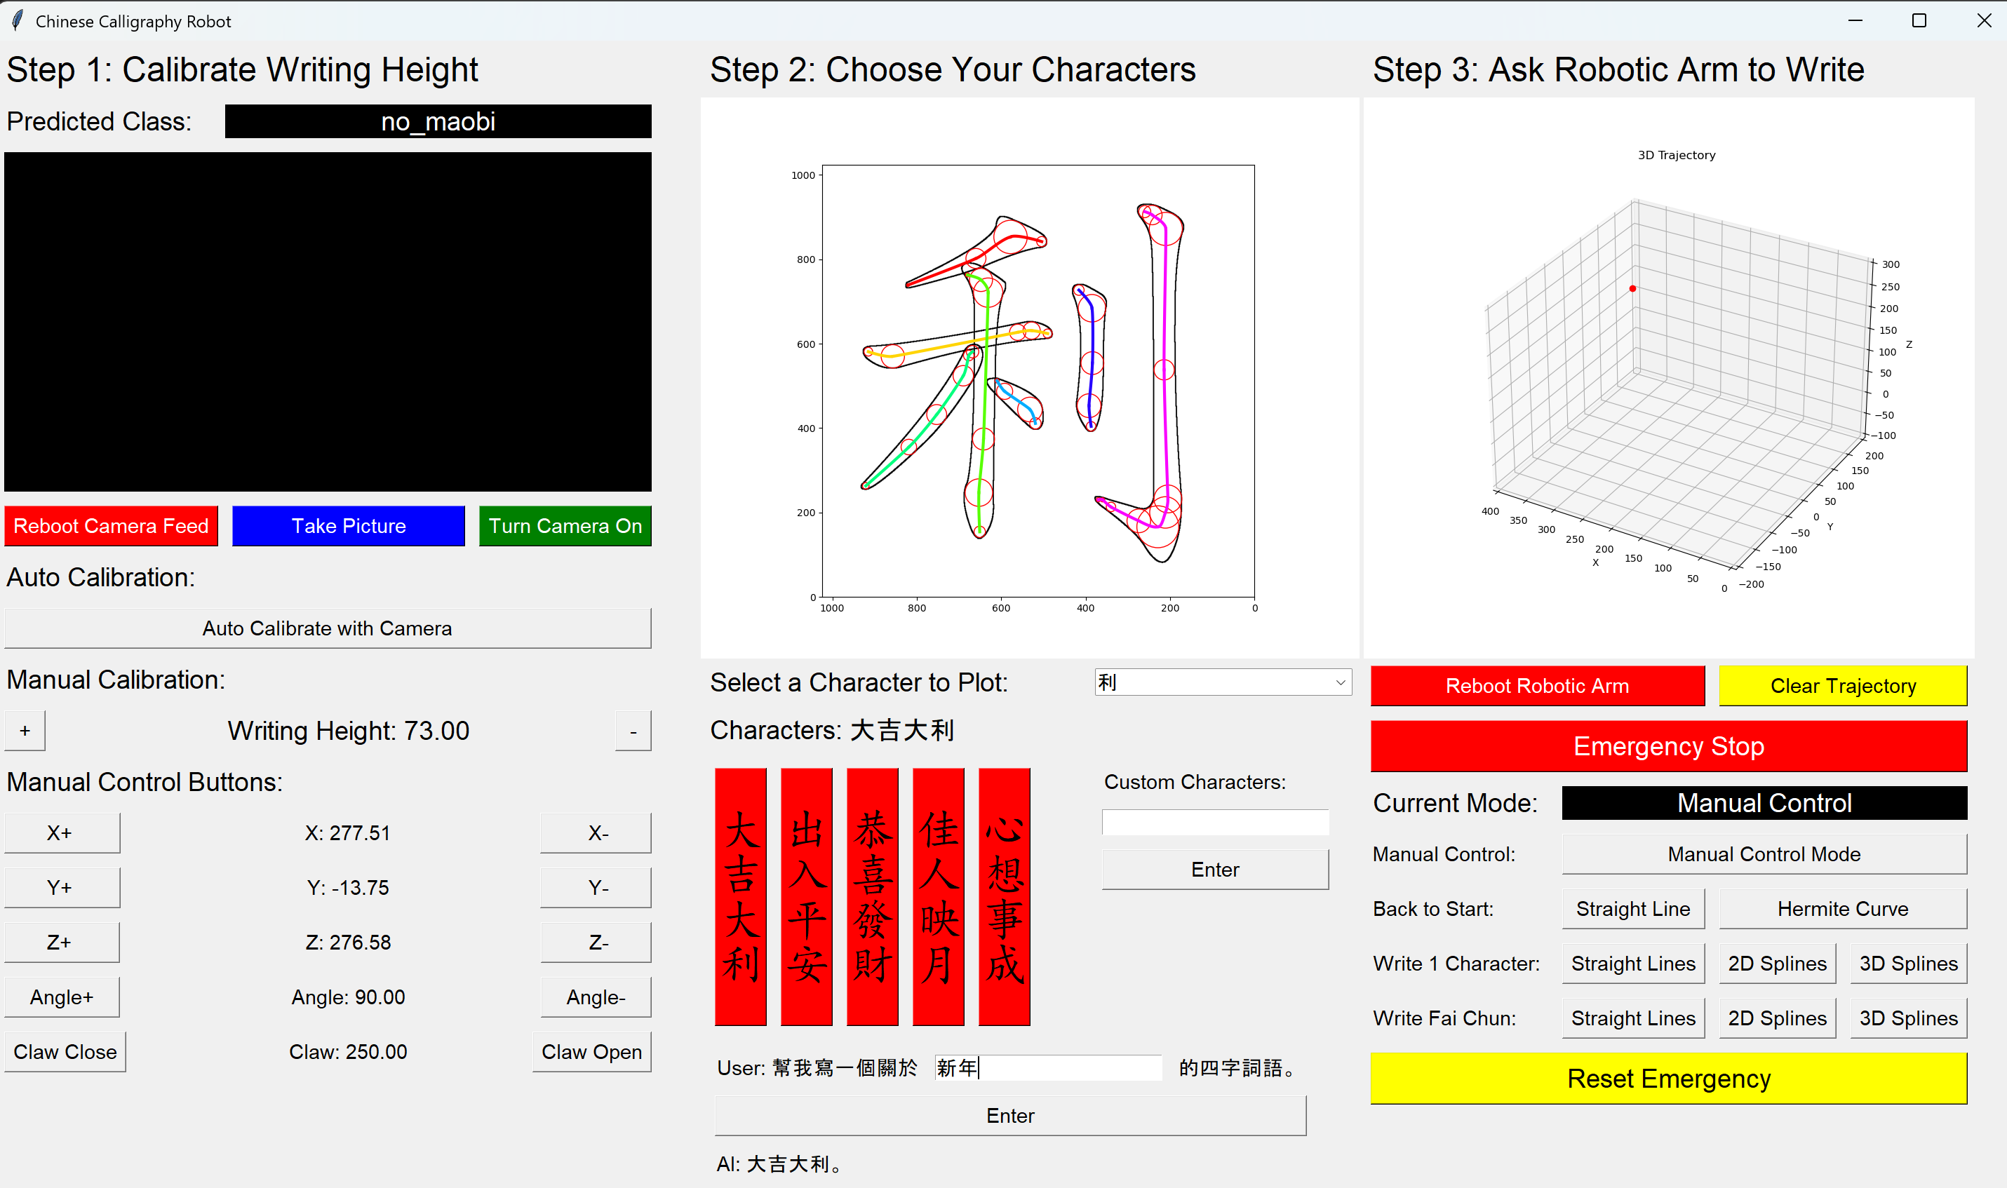
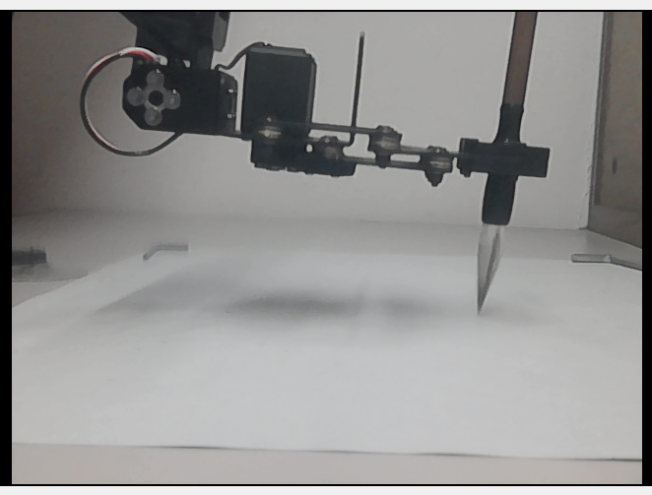
User Interface
Notes:
So, this is a simple UI that controls the robotic arm

Slide 28
03
FINAL RESULTS
Results of this project
Notes:
Now, let’s show the results of our Chinese calligraphy robotic arm.

Slide 29
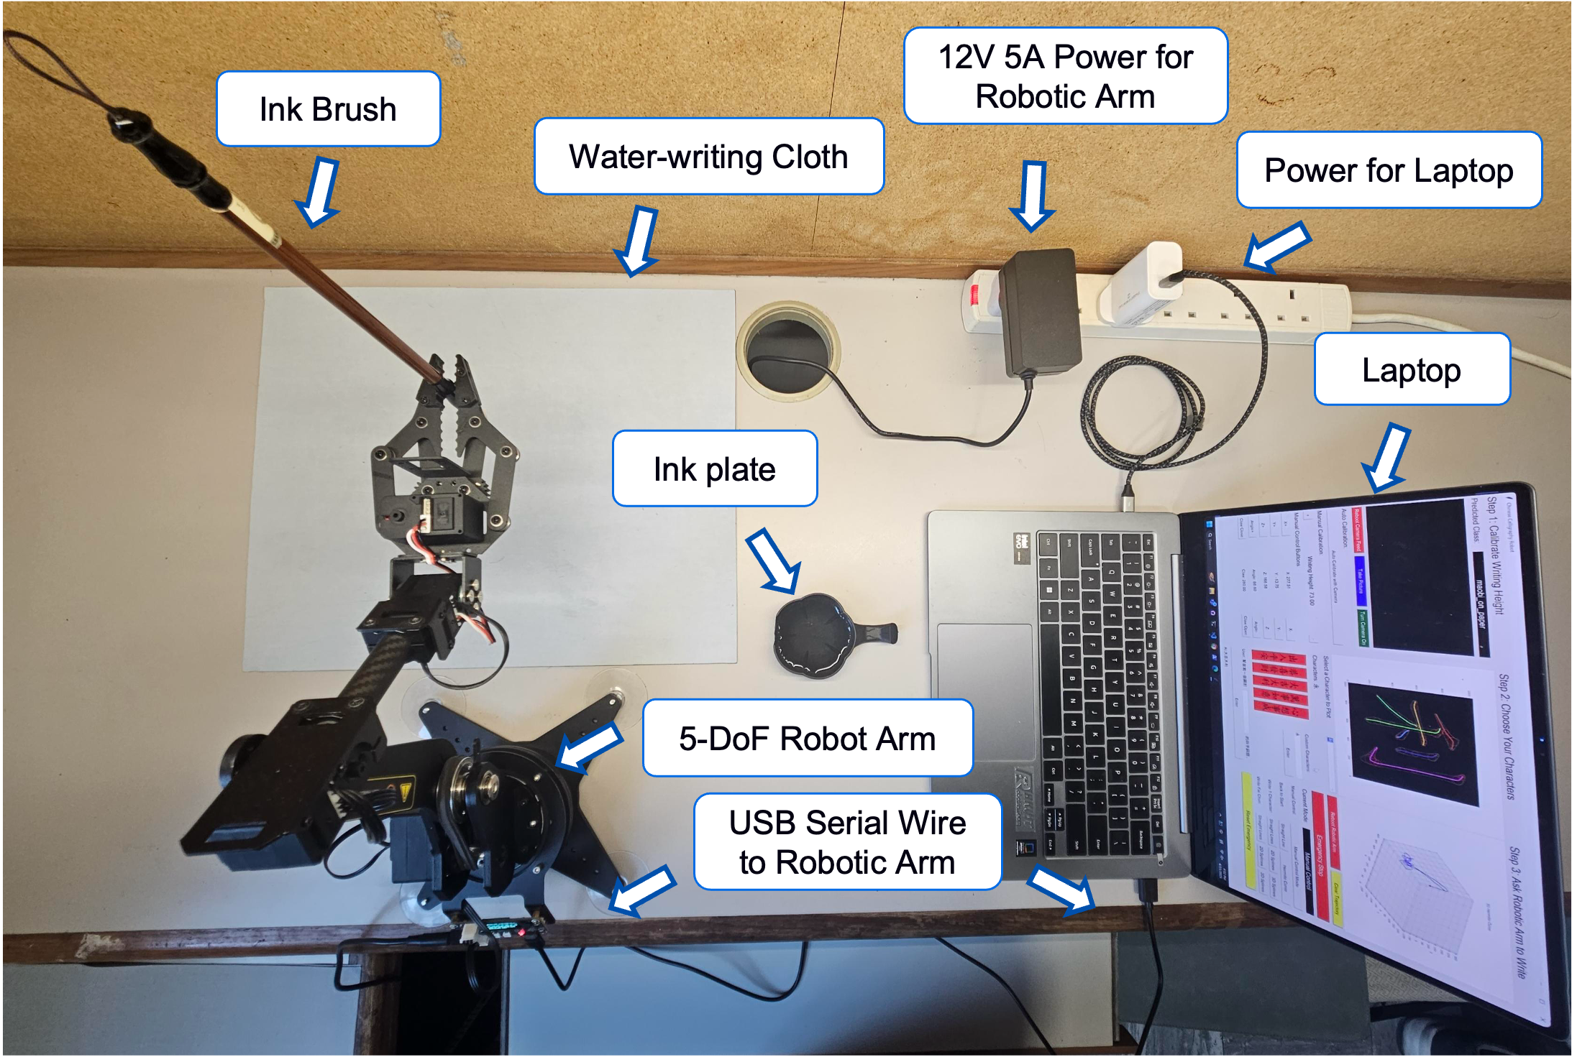
Experiment Setup
Notes:
So, this is the setup of our project. There is a 5-DoF robotic arm on the left that writes Chinese calligraphy on the white cloth, and a simple laptop on the right that controls the whole system.

Slide 30
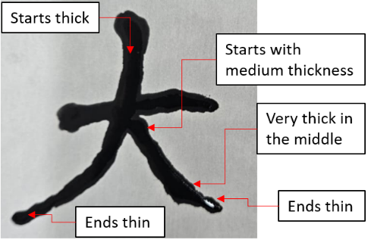
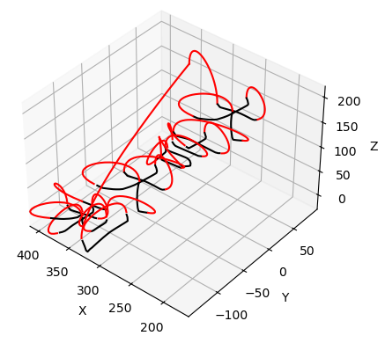
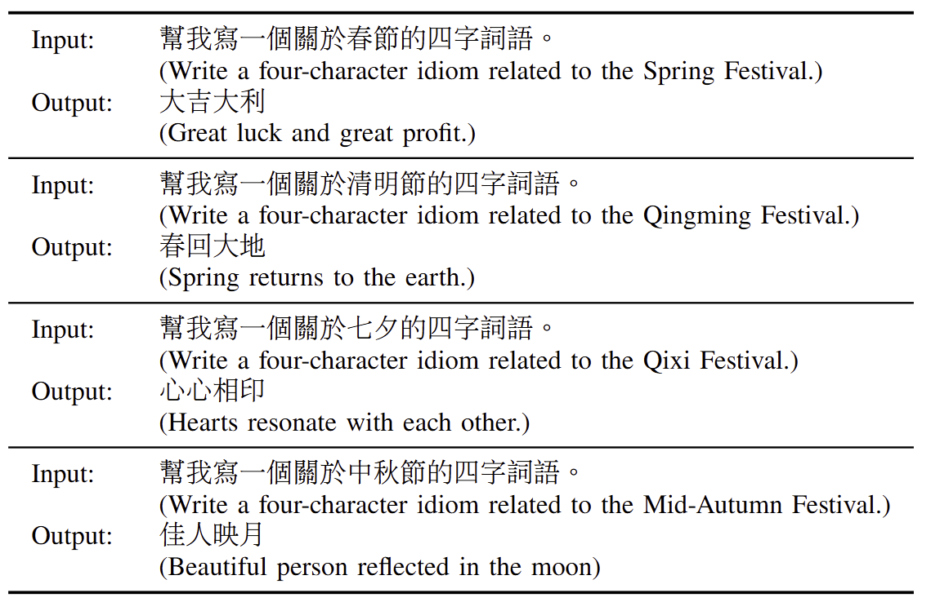






Some Test Results
Notes:
The final 3D Spline Algorithm has varying height, which creates varying brush thickness in the written words.

Slide 31
LLM Test Results
ChatGPT - 4o
Q: 幫我寫一個關於母親節
的四字詞語。
(Help me write a four-
character idiom related
to Mother’s Day.)
A: 恩重如山
(Gratitude as heavy
as a mountain)
Notes:
For the first part which is the LLM, we tested it with many different Chinese festivals like Chinese new year, Qing ming, Mid Autumn to see the results. It successfully outputs different relevant Chinese idioms for different festivals respectively.

Slide 32

3D Path Planning Test Results
Notes:
So, we used the LLM-generated results to generate the 3D control points. Then, we connect the control points into a full 3D trajectory. As a Chinese idiom has 4 characters, the result here shows a full trajectory that writes the 4 characters at the same time.

Slide 33
Robot Calligraphy Test Results
Notes:
And this is the resulting calligraphy written by the robotic arm. We can see the characters are written with various thickness in different positions within a stroke. So, we can see this stroke: it starts thick and ends very thin. And we can see this stroke: it starts with medium thickness, press to make it thick in the middle, the ends with a thin tip. This shows that by converting the control points into 3D, we can control the thickness of the brush stroke effectively.

Slide 34
04
VIDEO DEMO
Demo of this project

Slide 35

Demo in HKUST
Notes:
Here is a Demo I did in my university. So, we start the robotic arm with one of the LLM-generated Chinese idioms in the previous slides. We can see it draws with various thickness in one stroke. We can see that it actually ends with a much thinner tip than the images I shown in the previous slides. It is because the ink spreads around the paper immediately after the word is written. So, the thin tip appears to be much thicker than what it actually written.

Slide 36

THANKS
Track A1F2 CSR 1:
Control Systems & Robotics (CSR) 1
28 Oct 2025
Advanced 3D Path Planning for Robotic Calligraphy Based on LLM-Driven Text Prompts
Presenter 1: Cheuk Tung Shadow YIU,
Presenter 2: Dick Ho CHEUNG (Dicaprio),
Co-Author: Haolun Huang,
Supervisor: Professor Kam Tim Woo
Notes:
So, this is the end of our presentation. Thank you.

Slide 37
Questions & Answers

